Slide 1
Kaggle 案例分析
－Santander Customer Satisfaction
顏家佑、沈祐珍、黃侲艗

Slide 2
Kaggle 案例分析
Santander Customer Satisfaction
01. 案例簡介
02. Script介紹
03. Xgboost應用

Slide 3


案例簡介
Santander Customer Satisfaction
Which customers are happy customers?
Santander Customer Satisfaction
2016由桑坦德銀行發起的Kaggle挑戰
找出對銀行服務很滿意與不滿意的顧客
第一名獎金：30,000美元

Slide 4
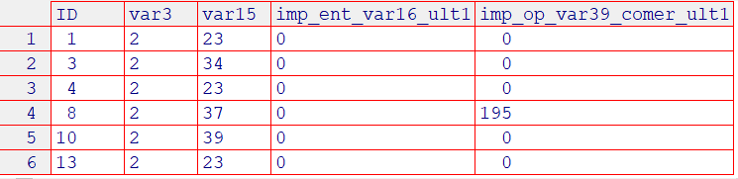
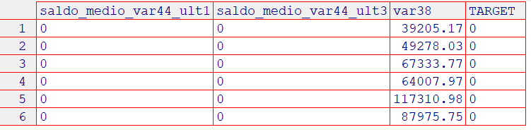


案例簡介
Santander Customer Satisfaction
資料簡介
The "TARGET" column is the variable to predict.
It equals 1 for unsatisfied customers and 0 for satisfied customers.

Slide 5
案例簡介
Santander Customer Satisfaction
資料簡介
Training data 訓練資料
Testing data 驗證資料
Used to build the model
Assess the quality of the model
Predict the TARGET variable using the XGBOOST model

Slide 6
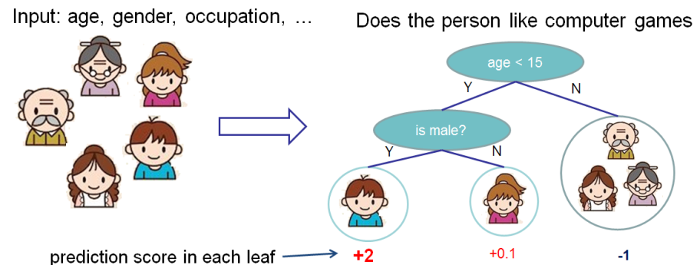
案例簡介
XGBoost
eXtreme Gradient Boosting (極限梯度提升)
利用分類和回歸樹(Classification and regression tree, CART)。
Do they feel satisfied with the bank service?
Notes:
我们把家庭中的成员分到了不同的叶子节点(classification)，同时每个叶子节点上都有一个分数。CART与决策树相比，细微差别在于CART的叶子节点仅包含判断分数(regression得到的)。在CART中，相比较于分类结果，每个叶子节点的分数给我们以更多的解释。

Slide 7
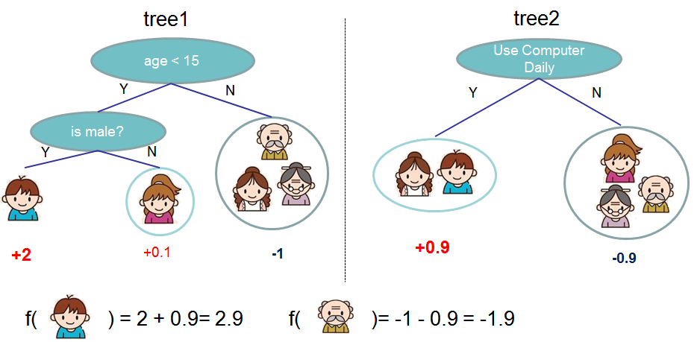
案例簡介
XGBoost
eXtreme Gradient Boosting (極限梯度提升)
利用分類和回歸樹(Classification and regression tree, CART)。
Notes:
Tree ensemble
通常情况下，在实践中往往一棵树是不够用的。这个时候往往需要把多棵树的预测结果综合起来，这就是所谓的复合树模型。

Slide 8




案例簡介
XGBoost
eXtreme Gradient Boosting (極限梯度提升)
利用分類和回歸樹(Classification and regression tree, CART)。
01
02
03
04
Train model
Perform prediction
Transform regression result into
binary classification
Evaluate
model performance
Notes:
The only thing that XGBoost does is a regression. XGBoost is using TARGET vector to build its regression model.
If we think about the meaning of a regression applied to our data, the numbers we get are probabilities that a datum will be classified as 1. Therefore, we will set the rule that if this probability for a specific datum is > 0.5 then the observation is classified as 1 (or 0 otherwise).
# The most important thing to remember is that to do a classification, you
# just do a regression to the label and then apply a threshold.

Slide 9
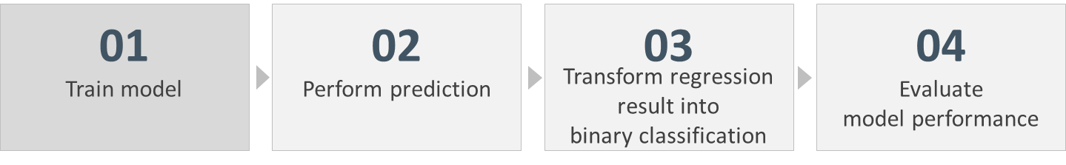
案例簡介
XGBoost
eXtreme Gradient Boosting (極限梯度提升)
training
data
booster
Basic : xgboost
Advanced: xgb.train
Sparse matrix
Dense matrix
Xgb.DMatrix
nonlinear link: “gbtree”
linear link: “gblinear”
Notes:
One of the special feature of xgb.train is the capacity to follow the progress of the learning after each round. Because of the way boosting works, there is a time when having too many rounds lead to an overfitting. You can see this feature as a cousin of cross-validation method. The following techniques will help you to avoid overfitting or optimizing the learning time in stopping it as soon as possible.
過適問題 (Overfitting)，所謂過適問題就是當模型在訓練資料集上的誤差低，但是在驗證資料集上的誤差非常高
不同訓練方式
不同演算法 decision tree / linear algorithm
不同資料格式 gb.Dmatrix 內建資料格式

Slide 10
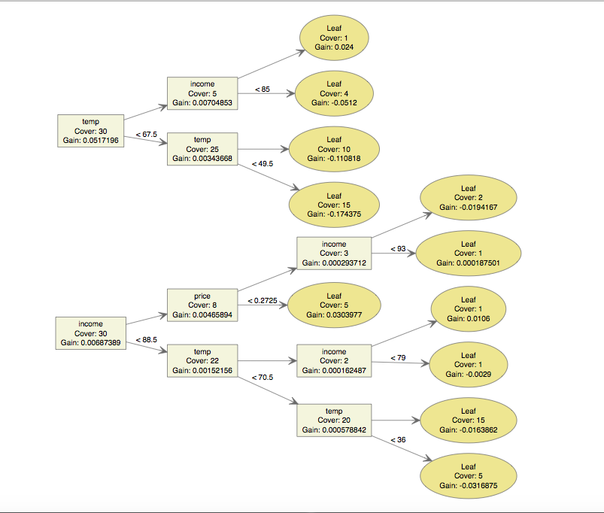
案例簡介
bst <- xgboost(data = train.data, label = Icecream$cons, max.depth = 3, eta = 1, nthread = 2, nround = 2, objective = "reg:linear")
XGBoost
eXtreme Gradient Boosting (極限梯度提升)
objective regression/classification/ranking
binary:logistic
nrounds the max number of iterations
(the number of decision trees in the final model)
max_depth maximum depth of the tree
eta step size of each boosting step [0,1]
nthread number of cpu thread used in training, if not set, all threads are used
Notes:
OBJECTIVE: It supports various objective functions, including regression, classification and ranking. The package is made to be extendible, so that users are also allowed to define their own objective functions easily.
nrounds: the number of decision trees in the final model
XGBoost has computed at each round the same average error metric than seen above (we set nrounds to 2, that is why we have two lines)
執行緒（英語：thread）是作業系統能夠進行運算排程的最小單位。它被包含在行程之中，是行程中的實際運作單位。

Slide 11
Kaggle 案例分析
Santander Customer Satisfaction
01. 案例簡介
02. Script介紹
https://rgmmmt4r.github.io/106-2_R_b04303117/project2/kaggle_group6_01copy.html
03. Xgboost應用

Slide 12
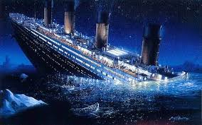
Xgboost應用
01. 資料來源
https://www.kaggle.com/c/titanic/data
Titanic: Machine Learning from Disaster
Xgboost
cForest
比賽誰預測鐵達尼號生存比較準
02. Xgboost
Xgboost號稱kaggle競賽神器
那將Xgboost與當時練習鐵達尼號用的cForest來比較

Slide 13
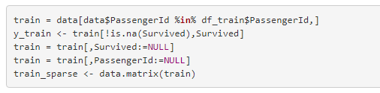
Xgboost應用
03. 變數
Pclass：艙等
Sex：性別
SibSp：兄弟姊妹、老婆丈夫數量
Parch：父母小孩的數量
Embarked：出發港口
Title：利用NAME找出Miss、Mrs
FsizeD：依據家庭大小分類(1,4,5)
isAlone：是否只有一個人
Fsize：家庭大小
Xgboost
cForest
比賽誰預測鐵達尼號生存比較準
04. Xgboost
將資料轉成sparse matrix才能跑

Slide 14
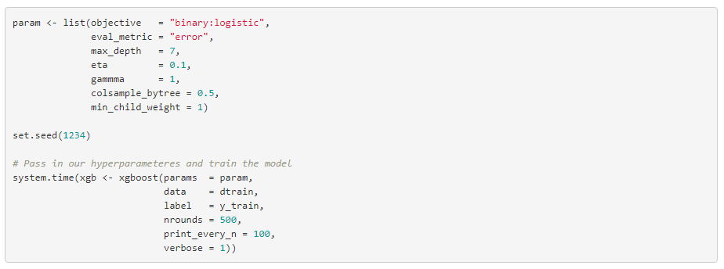
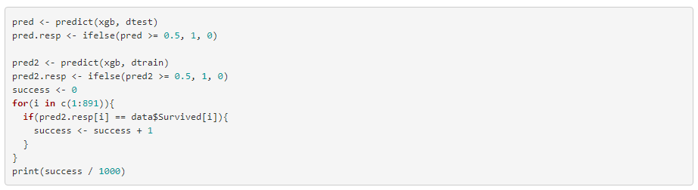
Xgboost應用
05. 設定hyperparameters
Xgboost
cForest
比賽誰預測鐵達尼號生存比較準
06. 預測模型，並利用原本的train資料測試準確率
準確率：0.863

Slide 15
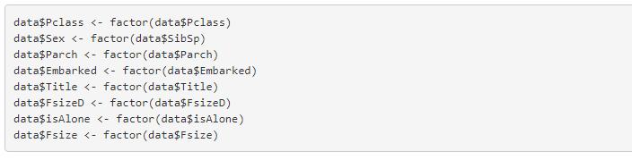
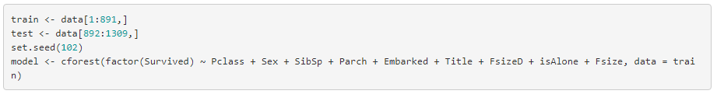
Xgboost應用
07. 用同一份資料與變數換cForest預測
將資料轉成factor
Xgboost
cForest
比賽誰預測鐵達尼號生存比較準
08. 建立cForest模型

Slide 16
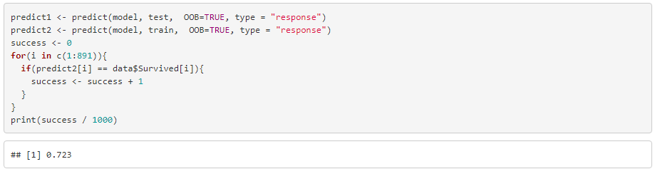
Xgboost應用
09. 預測模型，並利用原本的train資料測試準確率
準確率：0.723
Xgboost
cForest
比賽誰預測鐵達尼號生存比較準
10. 結論
Xgboost的準確率有0.863，而cForest只有0.723
Xgboost效率高、準確率高
Xgboost真的比較難！

Slide 17
Thank you

